Slide 1


Ecommerce
Data Analysis
SQL + Python

Slide 2
OVERVIEW
Unlock the potential hidden within your ecommerce data! This project dives deep into ecommerce performance metrics such as customer purchasing behaviors, year-on-year growth, seller revenue generation, and cumulative sales tracking. By leveraging both SQL and Python, this analysis offers comprehensive insights to help businesses optimize performance and drive growth.

Slide 3

TECH STACK
Languages
Python
SQL
Tools
SSMS
Jupyter Notebook
Libraries
NumPy
Pandas
Seaborn
Matplotlib
01
02
03

Slide 4
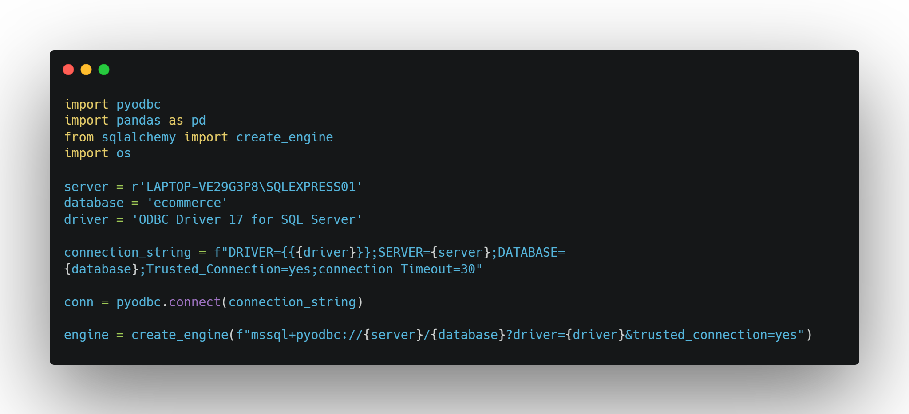
Prerequisite - Python to SQL connection

Slide 5
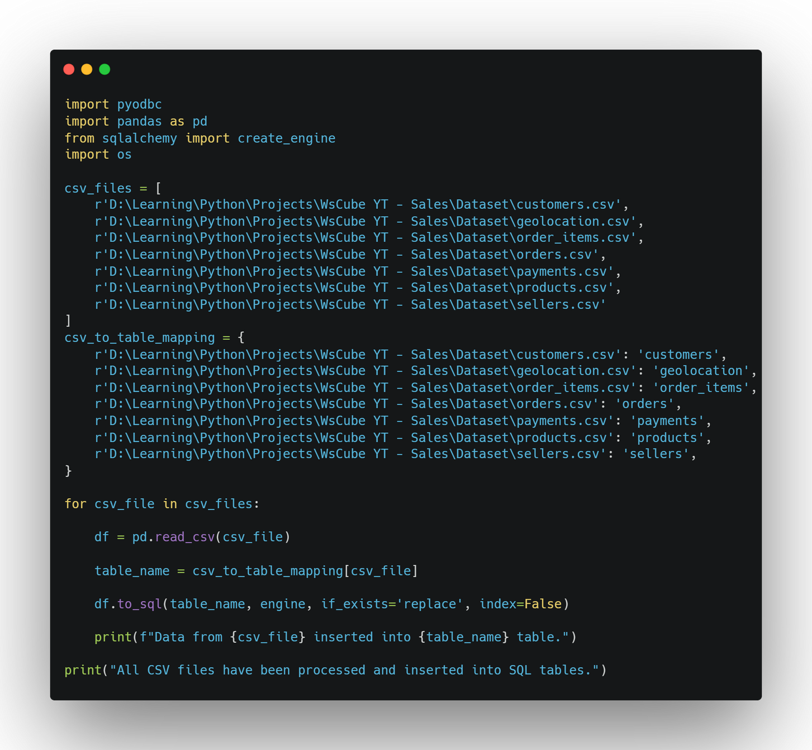
Data load into SQL from Python
01

Slide 6
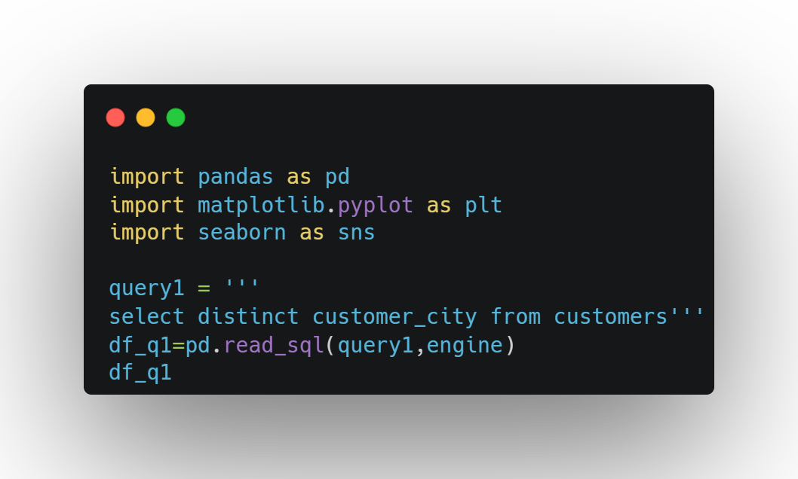
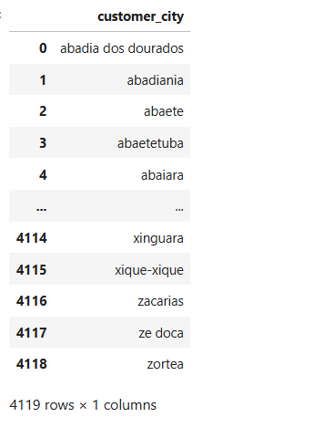
Problem Statement 1
List all unique cities where customers are located.

Slide 7
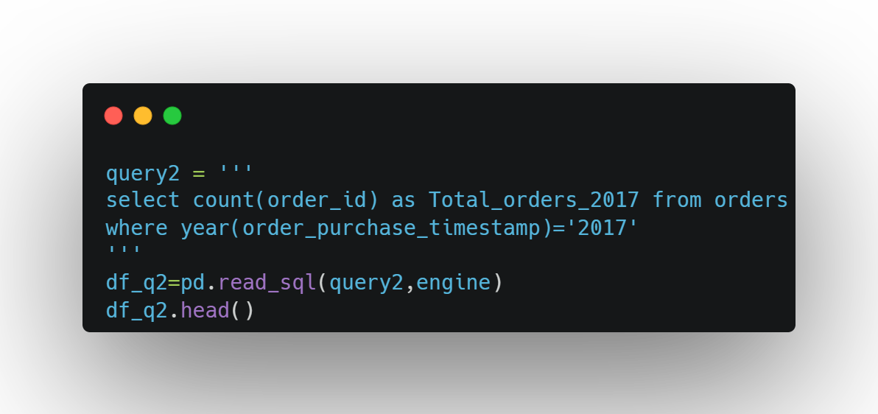
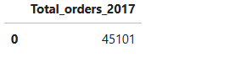
PROBLEM STATEMENT 2
COUNT THE NUMBER OF ORDERS PLACED IN 2017

Slide 8
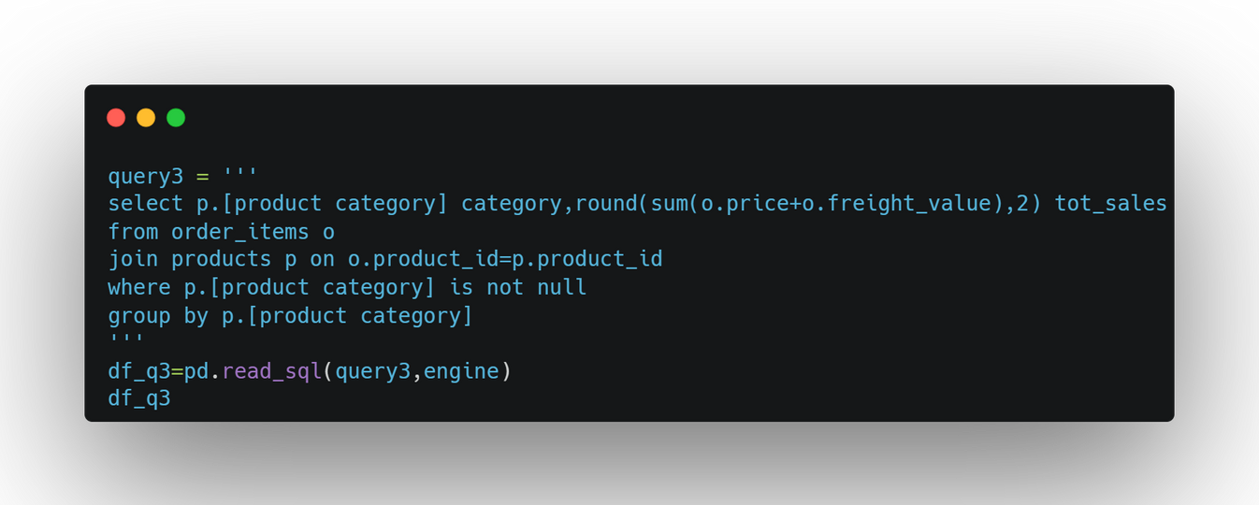
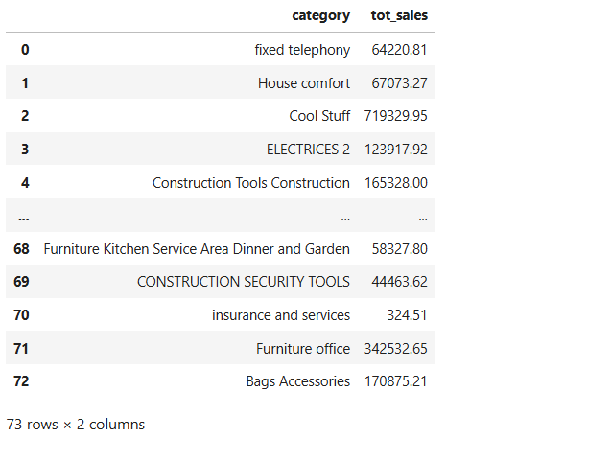
PROBLEM STATEMENT 3
FIND THE TOTAL SALES PER CATEGORY

Slide 9
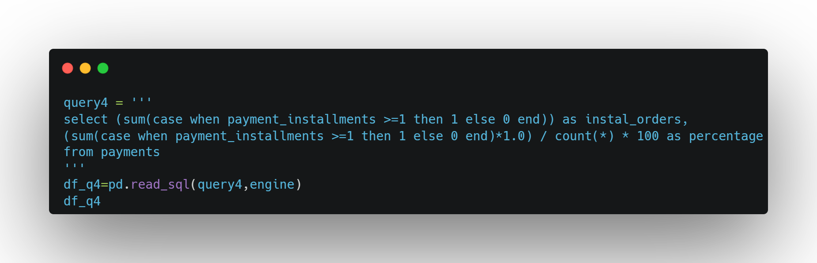
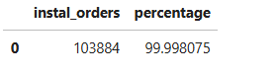
PROBLEM STATEMENT 4
CALCULATE THE PERCENTAGE OF ORDERS THAT WERE PAID IN INSTALLMENTS

Slide 10
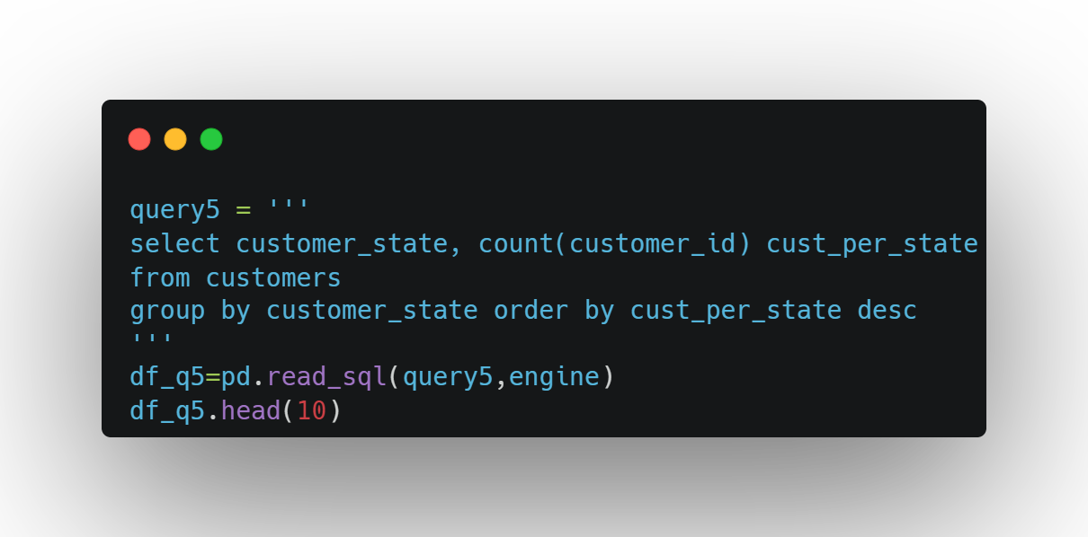
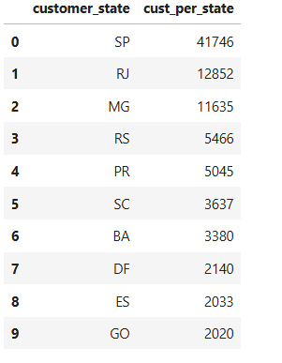
PROBLEM STATEMENT 5
COUNT THE NUMBER OF CUSTOMERS FROM EACH STATE.
Q5 continued >>>

Slide 11
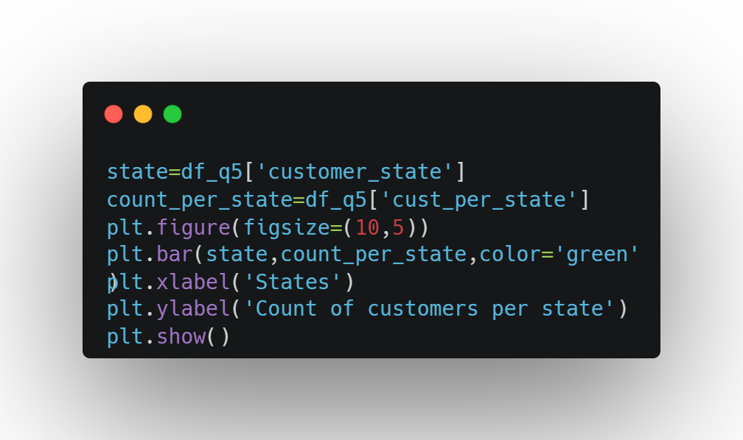
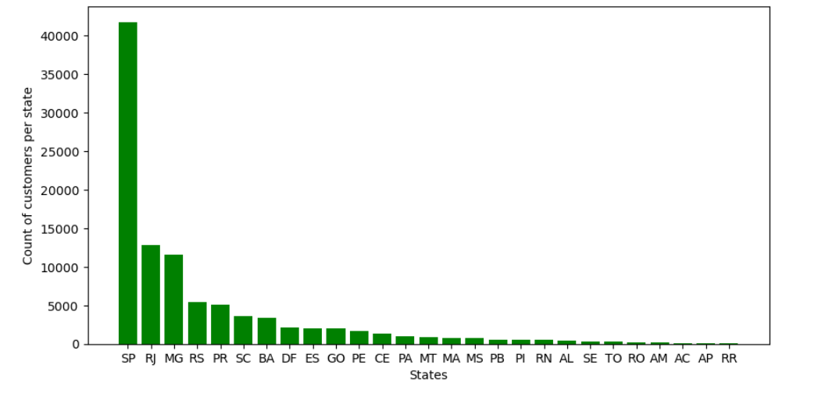

Slide 12
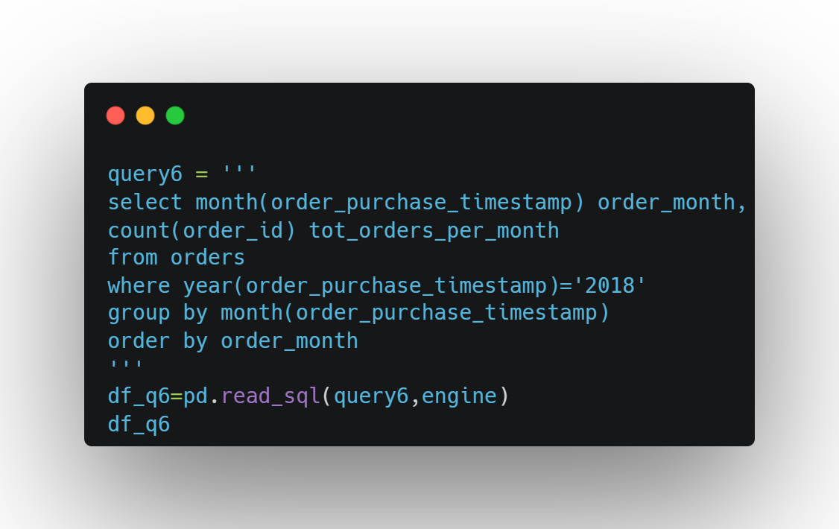
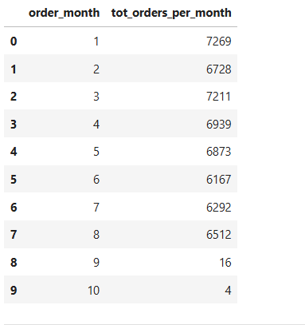
PROBLEM STATEMENT 6
CALCULATE THE NUMBER OF ORDERS PER MONTH IN 2018
Q6 continued >>>

Slide 13
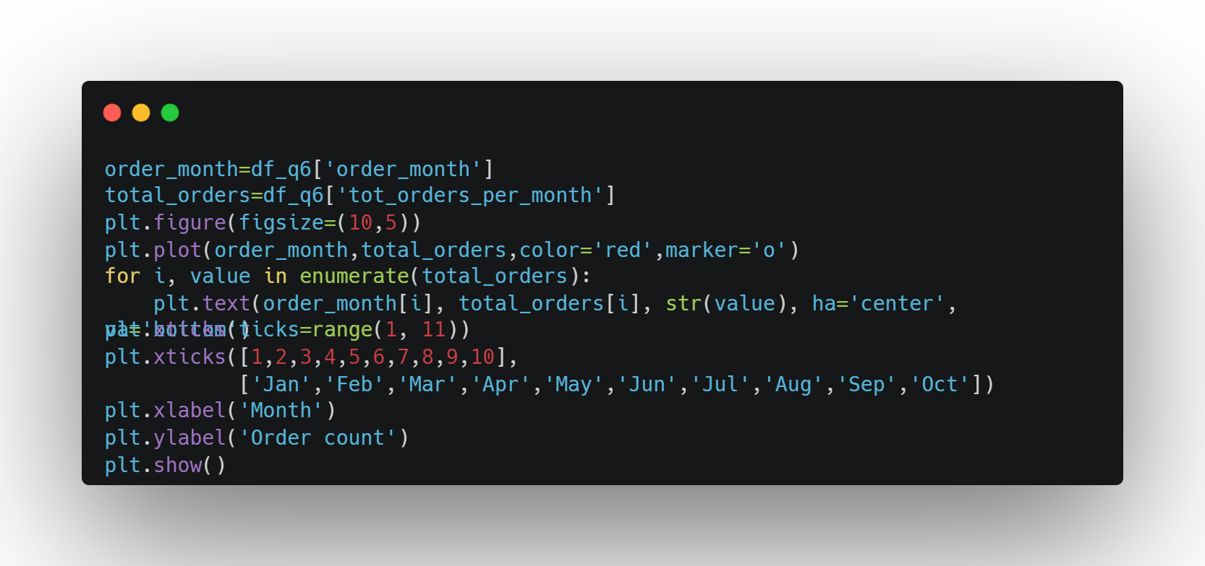
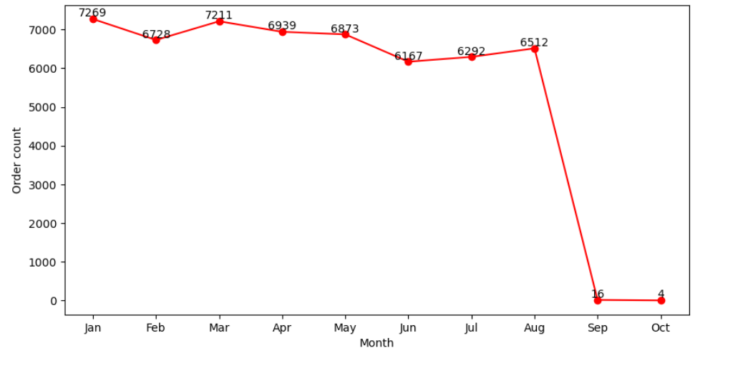

Slide 14
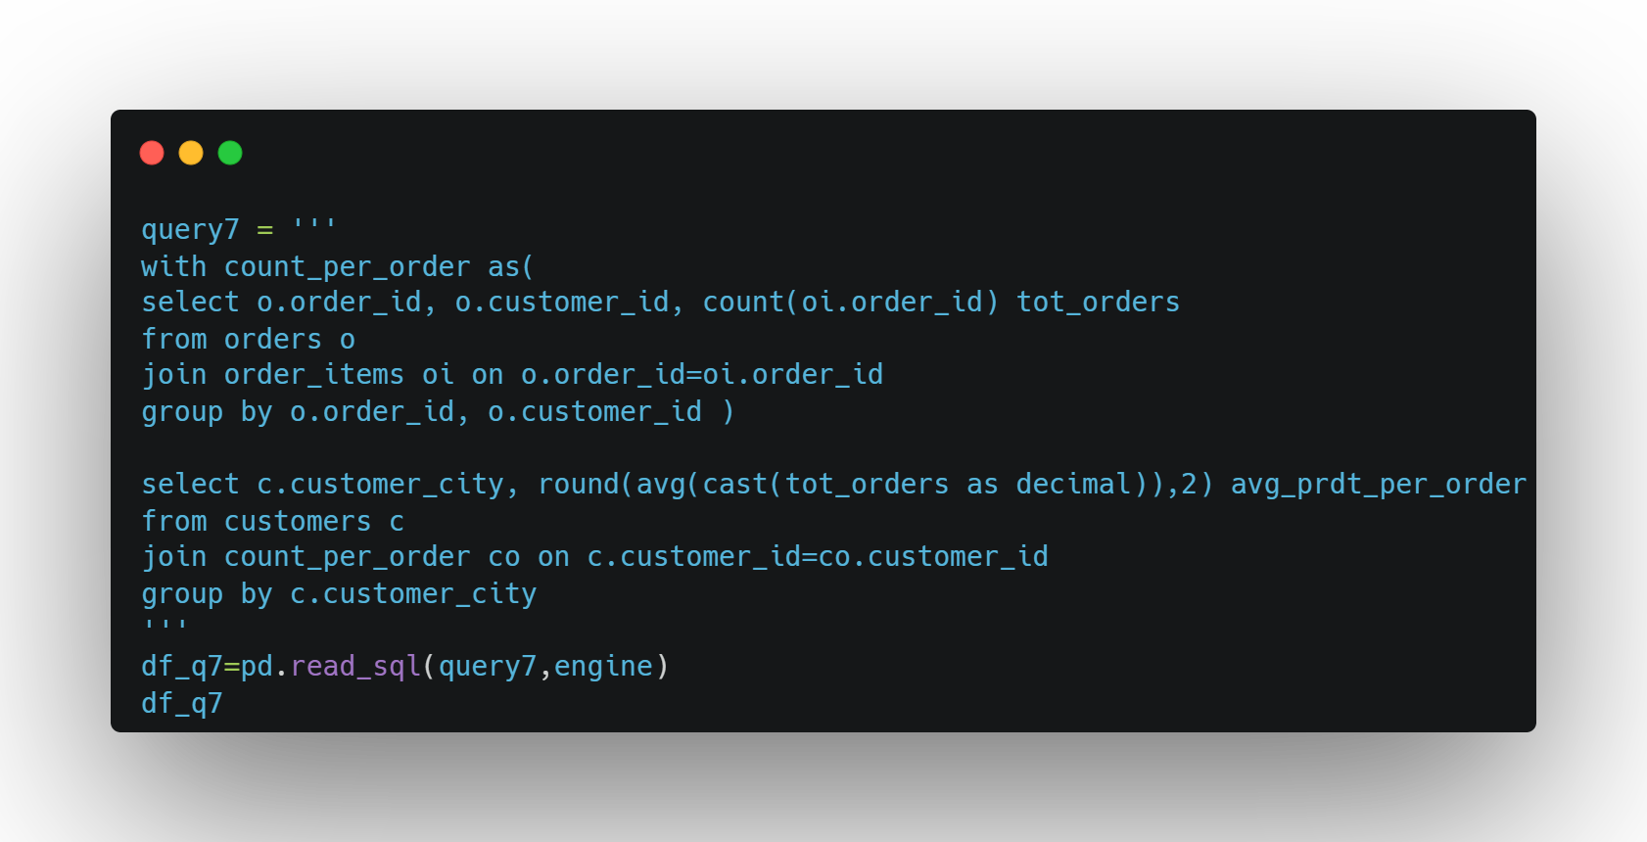
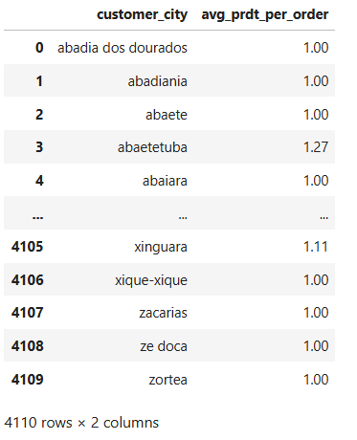
PROBLEM STATEMENT 7
FIND THE AVERAGE NUMBER OF PRODUCTS PER ORDER, GROUPED BY CUSTOMER CITY

Slide 15
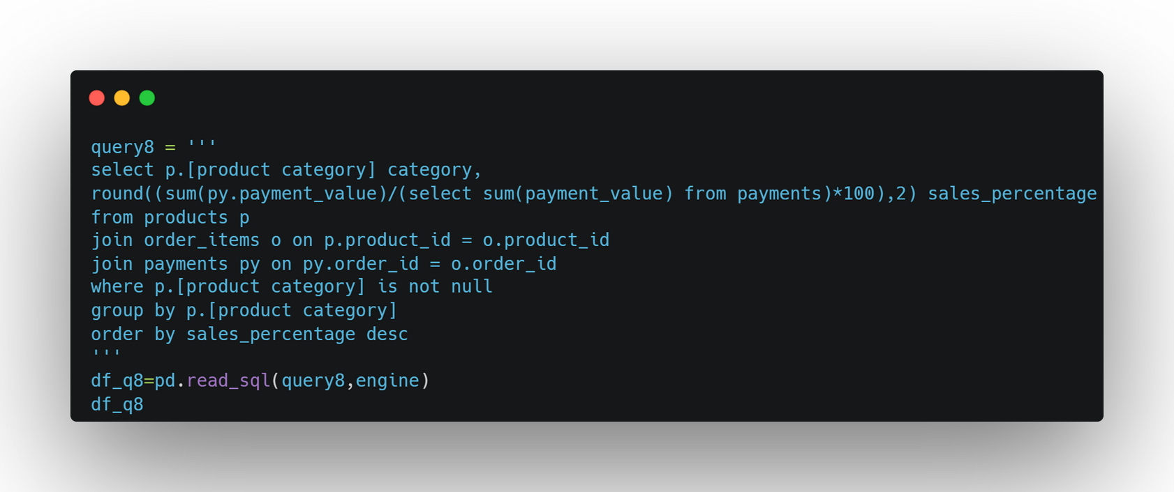
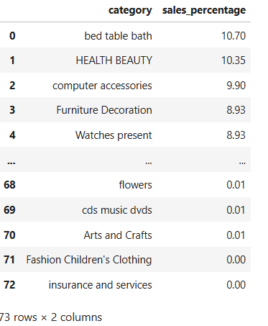
PROBLEM STATEMENT 8
CALCULATE THE PERCENTAGE OF TOTAL REVENUE CONTRIBUTED BY EACH PRODUCT CATEGORY
Q8 continued >>>

Slide 16
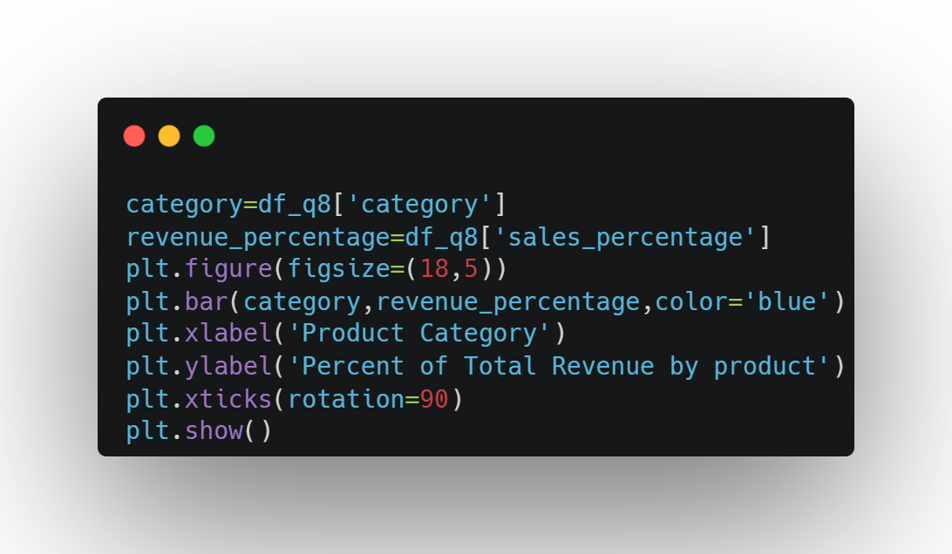
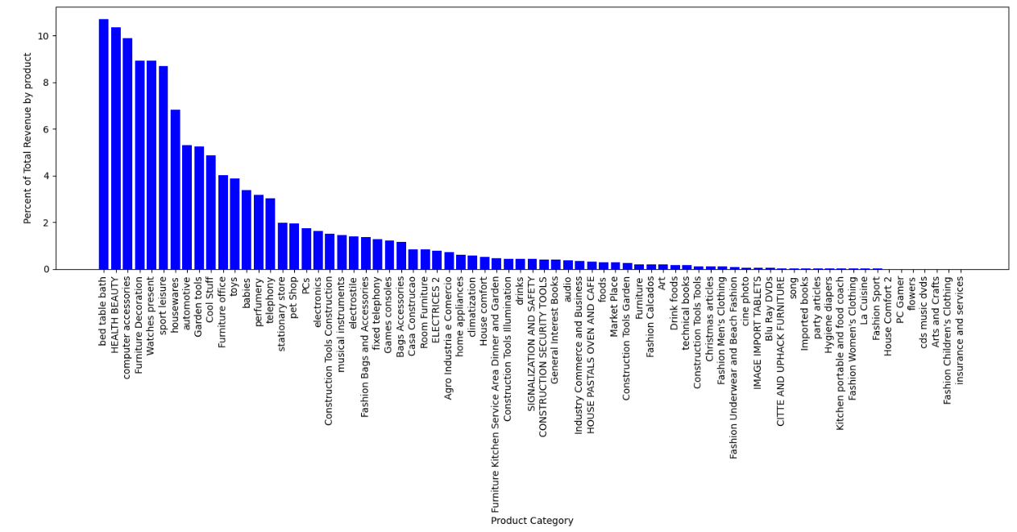

Slide 17
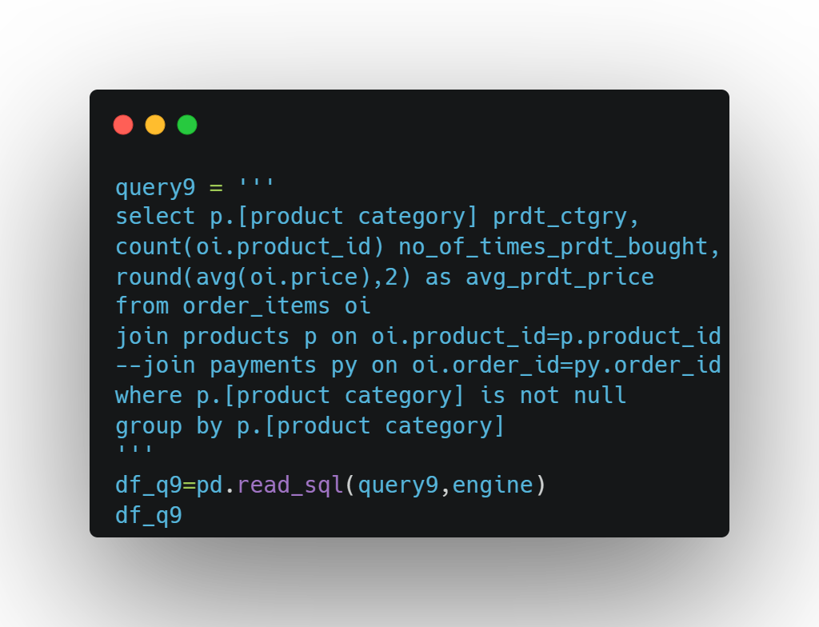
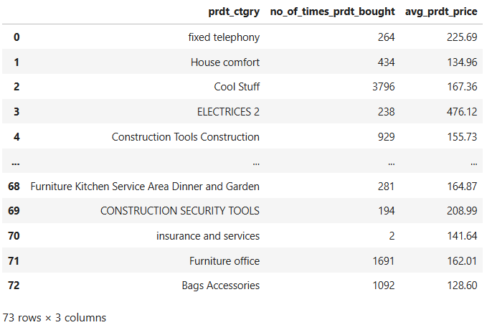
PROBLEM STATEMENT 9
IDENTIFY THE CORRELATION BETWEEN PRODUCT PRICE AND THE NUMBER OF TIMES A PRODUCT HAS BEEN PURCHASED
Q9 continued >>>

Slide 18
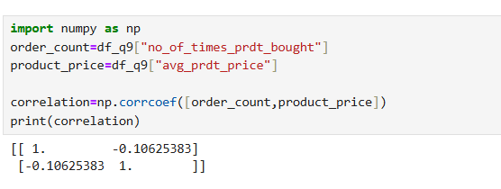

Slide 19
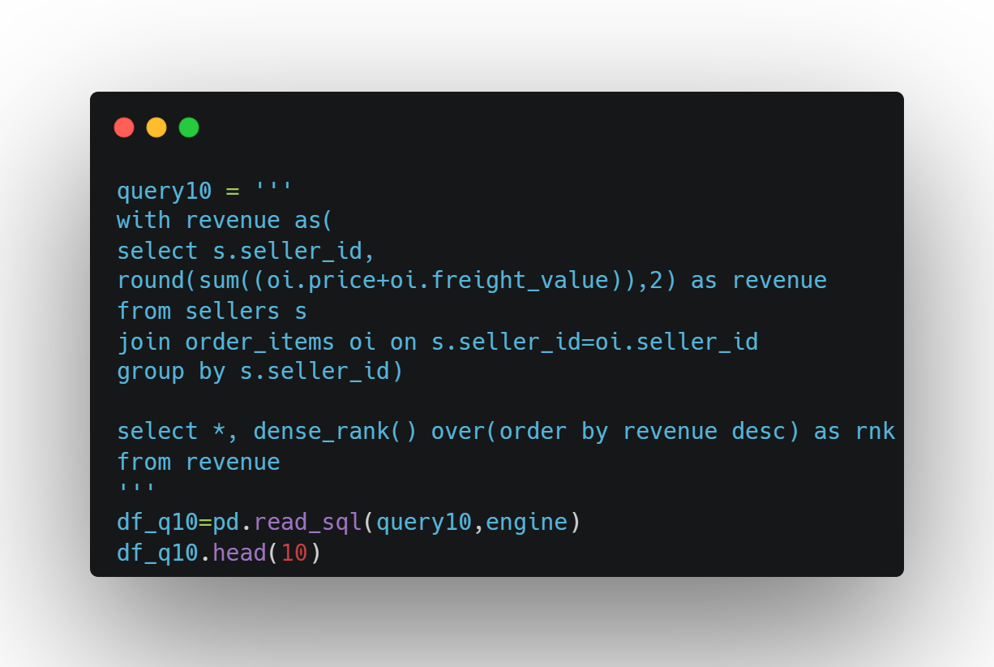
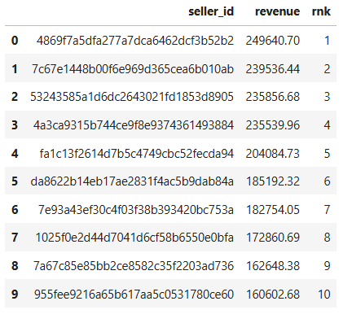
PROBLEM STATEMENT 10
CALCULATE THE TOTAL REVENUE GENERATED BY EACH SELLER, AND RANK THEM BY REVENUE

Slide 20
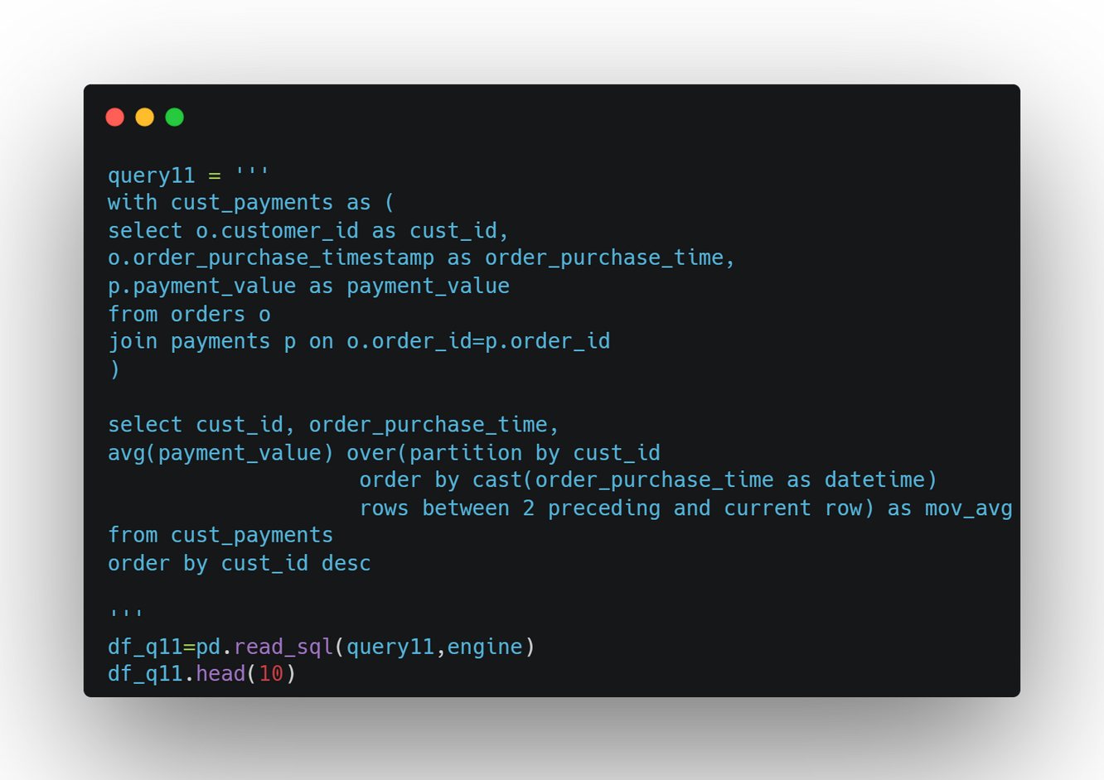
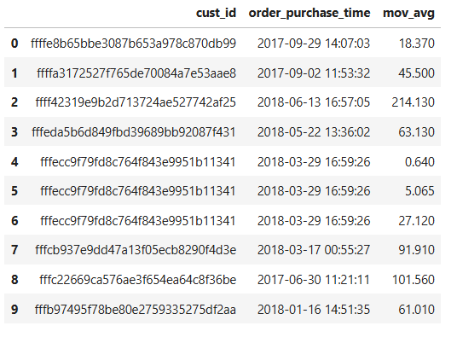
PROBLEM STATEMENT 11
CALCULATE THE MOVING AVERAGE OF ORDER VALUES FOR EACH CUSTOMER OVER THEIR ORDER HISTORY

Slide 21
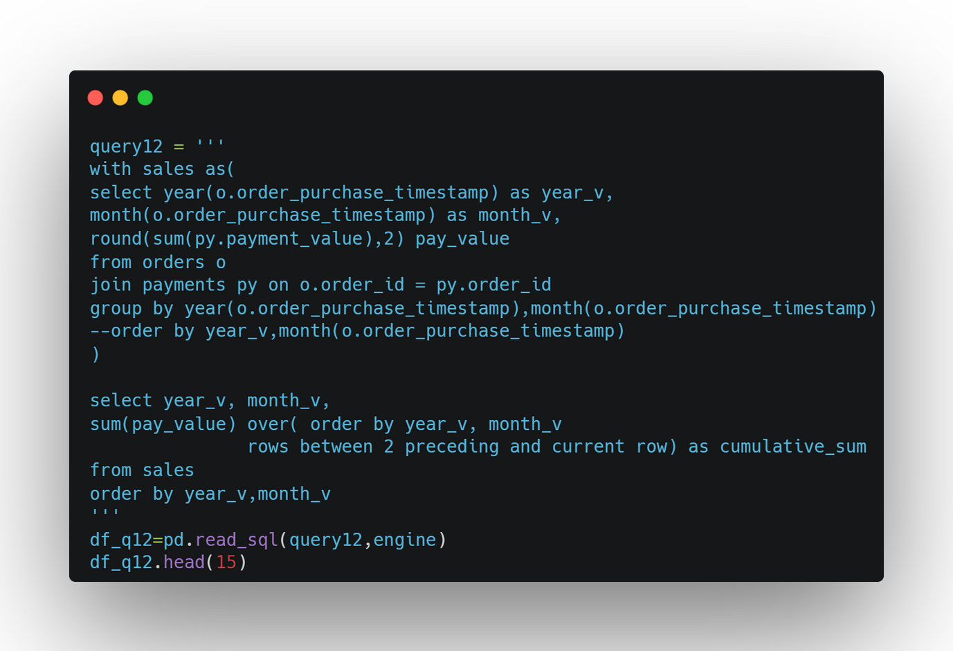
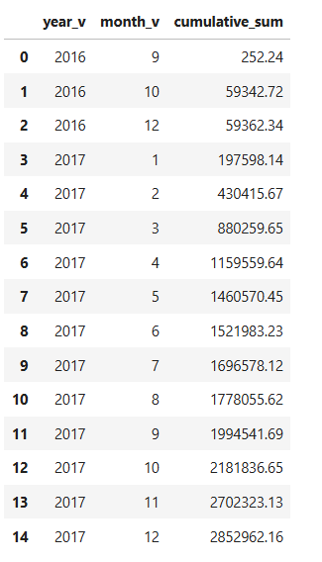
PROBLEM STATEMENT 12
CALCULATE THE CUMULATIVE SALES PER MONTH FOR EACH YEAR
Q12 continued >>>

Slide 22
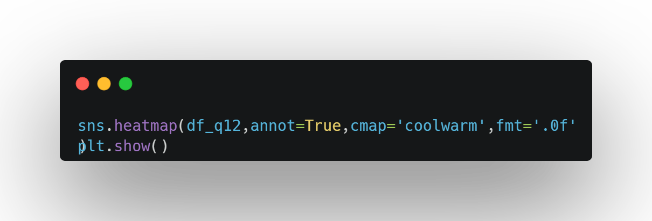
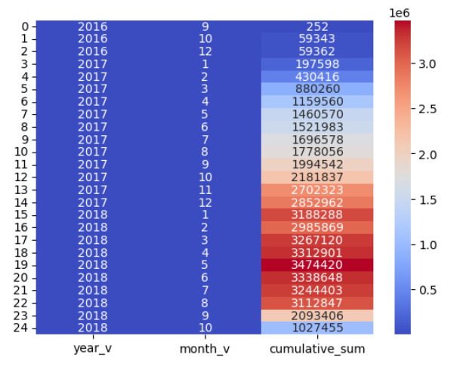

Slide 23
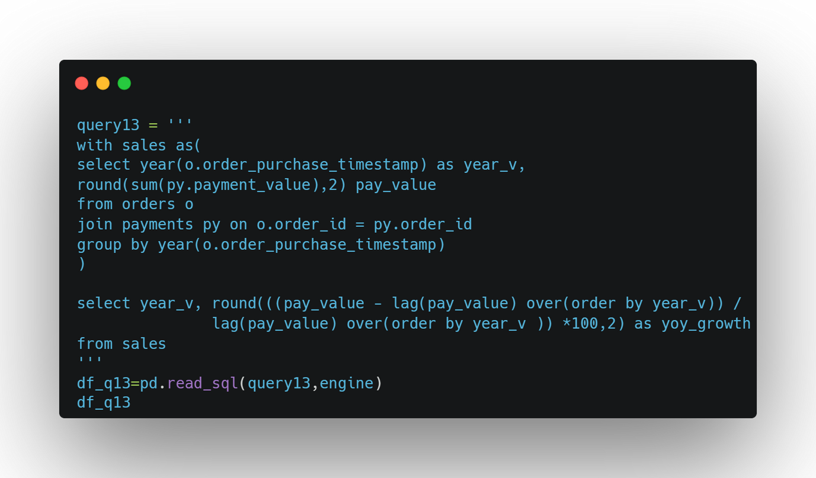
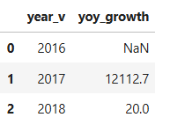
PROBLEM STATEMENT 13
CALCULATE THE YEAR-OVER-YEAR GROWTH RATE OF TOTAL SALES

Slide 24
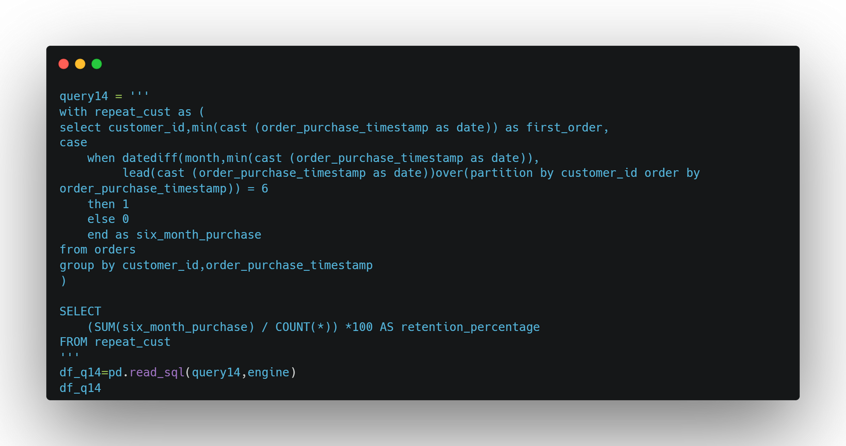
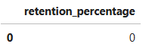
PROBLEM STATEMENT 14
CALCULATE THE RETENTION RATE OF CUSTOMERS, DEFINED AS THE PERCENTAGE OF CUSTOMERS WHO MAKE ANOTHER PURCHASE WITHIN 6 MONTHS OF THEIR FIRST PURCHASE

Slide 25
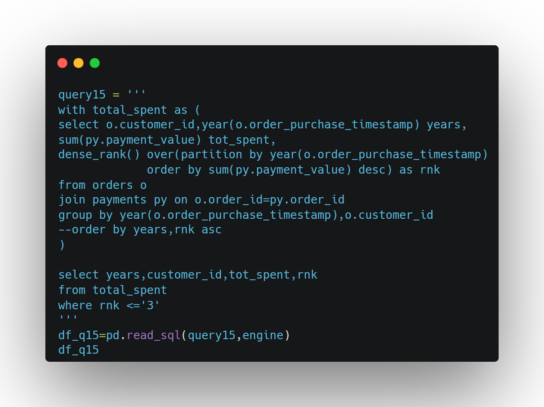
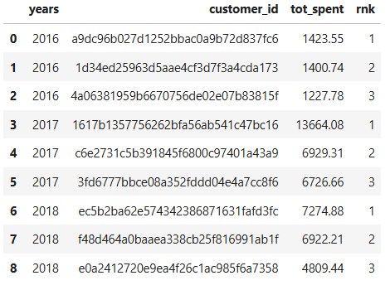
PROBLEM STATEMENT 15
IDENTIFY THE TOP 3 CUSTOMERS WHO SPENT THE MOST MONEY IN EACH YEAR
Q15 continued >>>

Slide 26
